Slide 1
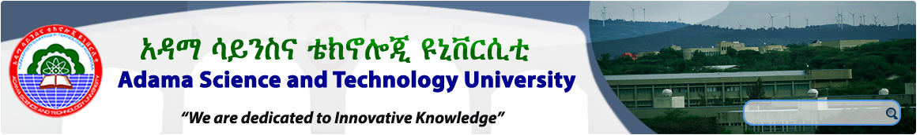
Chapter Two
Requirements Process

Slide 2
Topics to be covered
Process Models Process Actors Process Support and Management Process Quality and Improvement

Slide 3
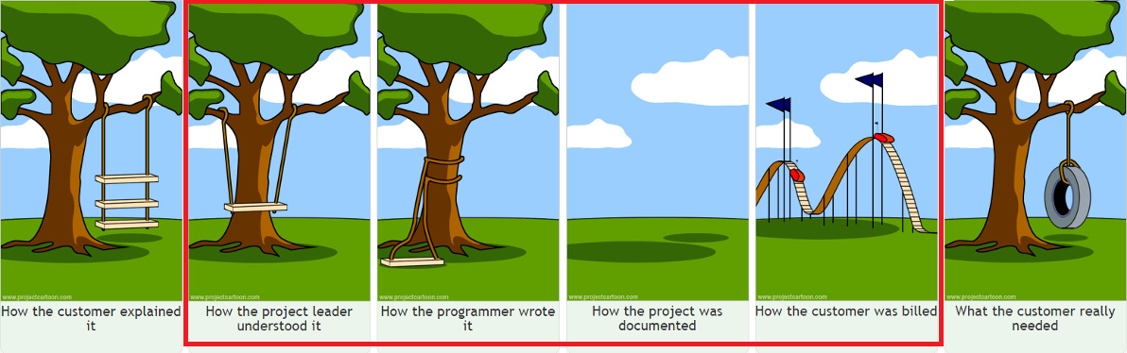

Slide 4
  Process models
Requirements engineering processes may include four high-level activities.
  Assessing if the system is useful to the business (feasibility study),
  Discovering requirements (elicitation and analysis),
  Converting these requirements into some standard form (specification), and
  Checking that the requirements actually define the system that the customer wants (validation).

Slide 5
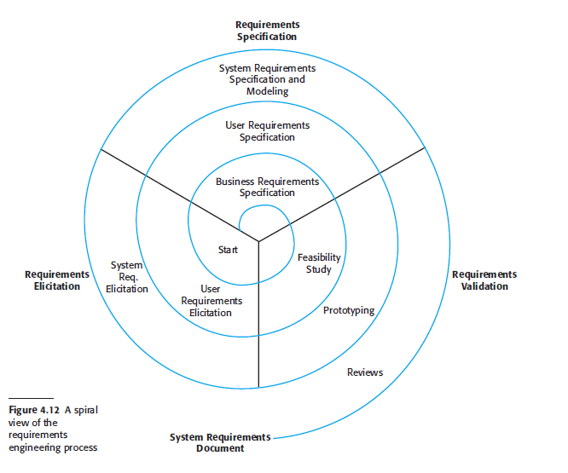
Cont’d…
However, in practice these activities are interwoven, incremental, and iterative.

Slide 6
Requirements feasibility study
A feasibility study decides whether or not the proposed system is worthwhile.
A short focused study that checks
  If the system contributes to organizational objectives;
  If the system can be implemented using current technology, within given cost and schedule constraints;
  If the system can be integrated with other systems that are already in place.

Slide 7
Feasibility study implementation
Feasibility study involves information assessment (what is required), information collection and report writing.
Questions for people in the organization for information assessment and collection:
  What if the system wasn’t implemented?
  What are current process problems?
  How will the proposed system help?
  What will be the integration problems?
  Is new technology needed? What skills?
  What facilities must be supported by the proposed system?
  Feasibility study report should make a recommendation about the development to continue or not.

Slide 8
Requirements Elicitation and Analysis
In this activity, software engineers work with customers and system end-users to find out about:-
  The application domain,
  What services the system should provide,
  The required performance of the system, and
  Hardware constraints, and so on.
  May involve end-users, managers, engineer involved in maintenance, domain experts, etc. These are called stakeholders.

Slide 9
Cont’d…
Eliciting & understanding stakeholder requirement is difficult due to the following reasons:
  Stakeholders don’t know what they really want except in most general.
  Stakeholders express requirements in their own terms.
  Different stakeholders may have different requirements.
  Organizational and political factors may influence the system requirements.
  The requirements change during the analysis process. New stakeholders may emerge and the business environment change.

Slide 10
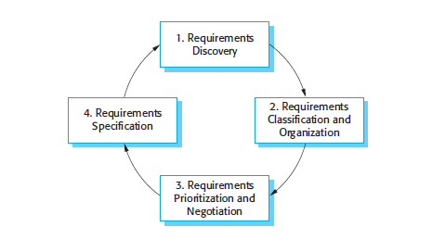
Elicitation and analysis process

Slide 11
Cont’d…
Requirements discovery
  Interacting with stakeholders to discover their requirements. Domain requirements are also discovered at this stage.
Requirements classification and organization
  Group related requirements and organizes them into coherent clusters.
Requirements prioritization and negotiation
  Prioritizing requirements and finding and resolving requirements conflicts.
Requirements specification
  Requirements are documented and input into the next round of the spiral.

Slide 12
Requirements Discovery
The process of gathering information about the proposed and existing systems and distilling the user and system requirements from this information.
Approaches & techniques of requirements discovery are:
  Questionnaire
  Interviewing
  Scenario
  Ethnography
  Document analysis
  Use-cases etc.

Slide 13
Requirements Specification
The essence of requirements specification is to document requirements of different types in a consistent, accessible, and reviewable way that is readily understandable by the intended audiences.
User requirements typically are represented in the form of use cases or user stories.
Detailed software functional and non-functional requirements are recorded in this specification, software requirements specification (SRS).

Slide 14
Requirements Validation
Concerned with demonstrating that the requirements define the system that the customer really wants.
Validation is so important because errors in a requirements document can lead to extensive rework costs. (when problems are discovered during development or after the system is in service.)
Fixing a requirements error after delivery may cost up to 100 times the cost of fixing an implementation error.

Slide 15
Requirements checking
Validity: Does the system provide the functions which best support the customer’s needs?
Consistency: Are there any requirements conflicts?
Completeness: Are all functions required by the customer included?
Realism: Can the requirements be implemented given available budget and technology?
Verifiability: Can the requirements be checked?

Slide 16
Requirements validation techniques
Requirements reviews
  Systematic manual analysis of the requirements.
Prototyping
  Using an executable model of the system to check requirements.
Test-case generation
  Developing tests for requirements to check testability.
  If test is difficult or impossible to design for the requirement means it is difficult to implement that requirement.

Slide 17
Process actors
The roles of the people who participate in the requirements process.
Fundamentally interdisciplinary.
The requirements specialist needs to mediate between the domain of the stakeholder and that of software engineering.

Slide 18
Cont’d…
There are often many people involved besides the requirements specialist, each of whom has a stake in the software.
The stakeholders will vary across projects, but will always include users/operators and customers.
Typical examples of software stakeholders include (but are not restricted to) the following:

Slide 19
Cont’d…
Users: This group comprises those who will operate the software (often heterogeneous group).
Customers: This group comprises those who have commissioned the software.
Market analysts: needed to establish what the market needs and to act as proxy customers.
Regulators: Many application domains, such as banking and telecom (Telebirr), are regulated. Therefore, the software must comply with the regulatory authorities.
Software engineers: individuals have a legitimate interest in profiting from developing the software.

Slide 20
Process support and management
Select an appropriate software development life cycle
  Each project manager should select and adapt the life cycle that best suits her project
Plan requirements approach
  should plan how it will handle its requirements development and management activities.
Estimate requirements effort
  know how long it’s going to take to develop the requirements for a project and what percentage of their total effort should be devoted to requirements development and management.

Slide 21
Cont’d…
Base project plans on requirements
  Develop plans and schedules for your project iteratively as the scope and detailed requirements become clear.
  Identify requirements decision makers
    Conflicting user inputs must be resolved, commercial package components must be selected, change requests must be evaluated, and on and on.
  Renegotiate project commitments when requirements change

Slide 22
Cont’d…
  Analyse, document, and manage requirements-related risks
    Identify and document risks related to requirements as part of the project’s risk-management activities
  Track the effort spent on requirements
    Monitor the effect that your requirements activities have on the project to help judge the return on your investment in requirements engineering.
  Review lessons learned regarding requirements on other projects

Slide 23
Process quality and improvement
Concerned with the assessment of the quality and improvement of the requirements process.
Its purpose is to emphasize the key role the requirements process plays in terms of the cost and timeliness of a software product and of the customer’s satisfaction with it.
It will help to orient the requirements process with quality standards and process improvement models for software and systems.

Slide 24
Cont’d…
Process quality and improvement is closely related to both the software quality & software engineering process and comprising:
    requirements process coverage by process improvement standards and models;
    requirements process measures and benchmarking;
    improvement planning and implementation;
    security/CIA - Confidentiality, Integrity and Availability improvement/planning and implementation

Slide 25
Reading Assignment
Chapter II: Requirement Process | Sommerville - 2011 | Wiegers – 2003
2.1. Process Models | Chapter 4 – section 4 | Chapter 3
2.2. Process Actors |  | Chapter 1, 2, 4 & 6
2.3. Process Support and Management |  | Chapter 3
2.4. Process Quality and Improvement |  | Chapter 22 & 23

Slide 26
END OF CHAPTER TWO

